Slide 1
WOA7001 - Advanced Algorithm Project
Interactive Visualization Interface of the spread of Covid 19
Group 1:
S2128427 - Dillon Leong Lon Zan (Leader)
S2117741 - Chong Kai Yang
S2127527 - Hongfei Ren
S2127462 - Tang Xue Jun

Slide 2
Introduction of Project
The project focuses on designing a data visualization algorithm to visualize the movement of people under the Covid-19 situation.
Data visualization technique is used to determine the correlation between the Infected Cases vs. Number of Check-ins per day.
Large datasets is suitable to be identified with data visualization techniques.

Slide 3
Project Objectives
Designing a survey to find the suitable datasets and graphing techniques.
Identifying the proper techniques for the data visualization of Covid-19 dataset.
A working data visualization interface is implemented to showcase the relationship between the Infected Cases vs. Number of Check-ins per day.
A graph algorithm implemented to showcase the movement between different Covid clusters.
Evaluate the graph algorithm from different people.

Slide 4
Roles
Leader – (Dillon Leong Lon Zan):
Manages the team
Provides documentation for the project
Creates the survey and evaluation form for the project.
Designer – (Chong Kai Yang):
Designs the data visualization technique for the project
Designs the data visualization interface
Implement the visualization technique into the website.

Slide 5
Roles
Main Code Developer – (Hongfei Ren):
Works on the data visualization of the project in Python.
Works on the graphing algorithm of the project in Python.
Assistant Code Developer – (Tang Xue Jun):
Assists in the graphing algorithm
Collaborates with the designer to provide reliable information to the main code developer.
Develop the website for the project.

Slide 6
Project Analysis
As our knowledge regarding the project is limited, it is required that we conduct the project with the thought of the Design Thinking Process.
The Design Thinking Process is separated into four steps:
Empathy
Ideate
Design
Prototype & Testing

Slide 7
Empathy
Different visualization techniques were considered.
A survey is designed to interview regarding other people’s opinions.
Datasets for visualization were also taken into consideration for the survey,

Slide 8
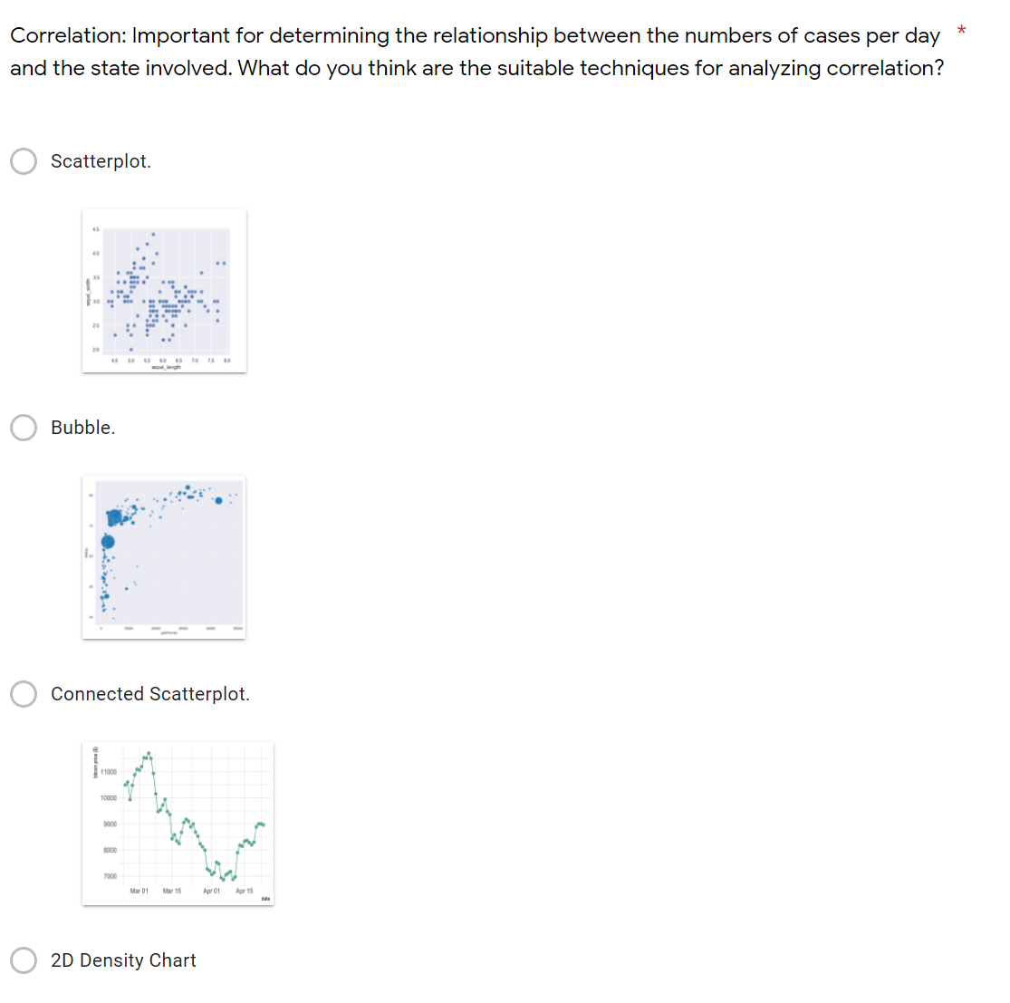
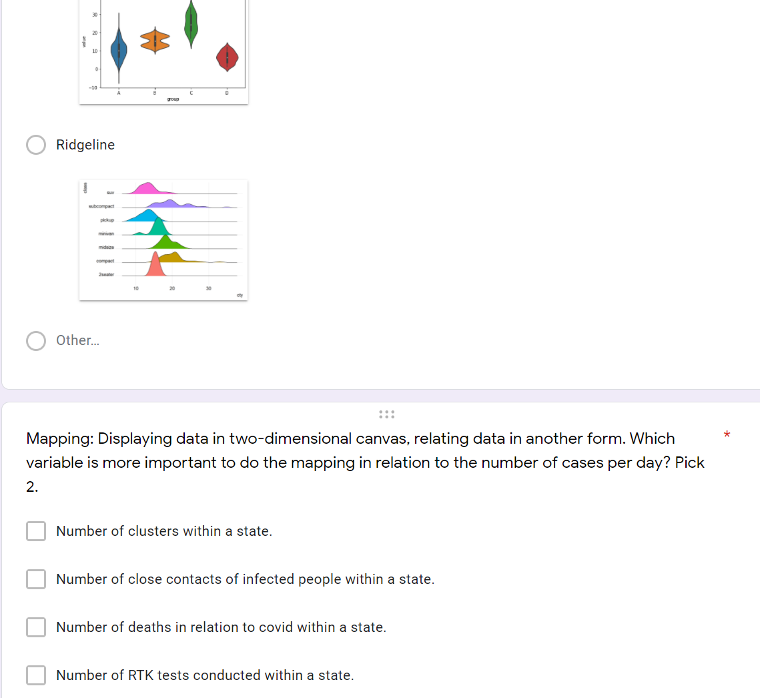
Empathy
Samples of survey form designed in Google form for interview.

Slide 9
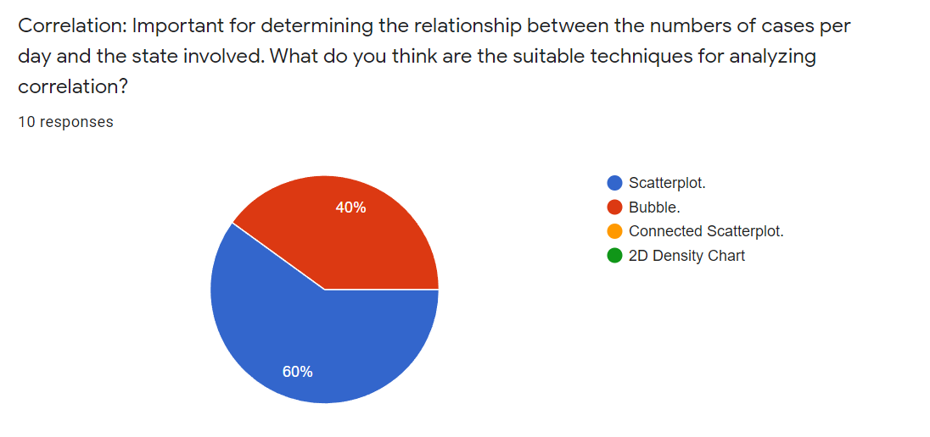
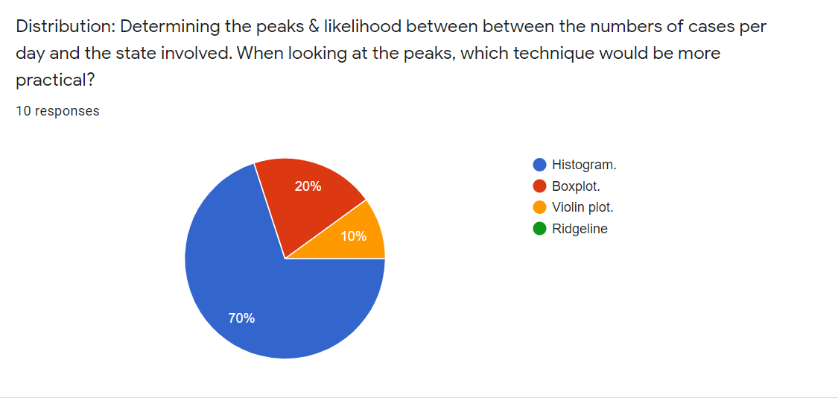
Empathy
Samples of survey results.

Slide 10
Ideate
Identifying datasets given for the project design：
Covid-19 Clusters
Check-in states
Check-in times every ½ hour
Infected cases in each state
Close contacts
Choosing the datasets:
Check-ins by state
New cases by state
New deaths by state
ICU admission by state
Vaccination by state
Clusters
Additional datasets:
Restriction status by state (MCO, NRP)
Population of state
Geographical coordinates of districts (Geocoded by GeoPY)
Data filtering:
Range of date: Entirety of the year of 2021
Location: 13 states and 3 federal territories of Malaysia

Slide 11
Design
Tableau is chosen to be our choice of data visualization software. Tableau is a popular interactive data visualization software with various chart features. Two dashboards are constructed to visualize the pandemic situation. The workflow is as described below:
01
Data collection & cleaning
Collect restriction status of states from Wikipedia and news websites
Compile list of districts (daerah) and obtain coordinates by geocoding
Restructure clusters dataset for graph network
02
Import to Tableau
Import all relevant datasets
Merge dataset by date and state
Only include data points that are recorded in 2021
03
Create charts
Area chart, scatter plot, network graph, table
Labelling (color, size, text)
04
Construct dashboard
Multiple charts joined to create a dashboard.
Add state and date filters

Slide 12
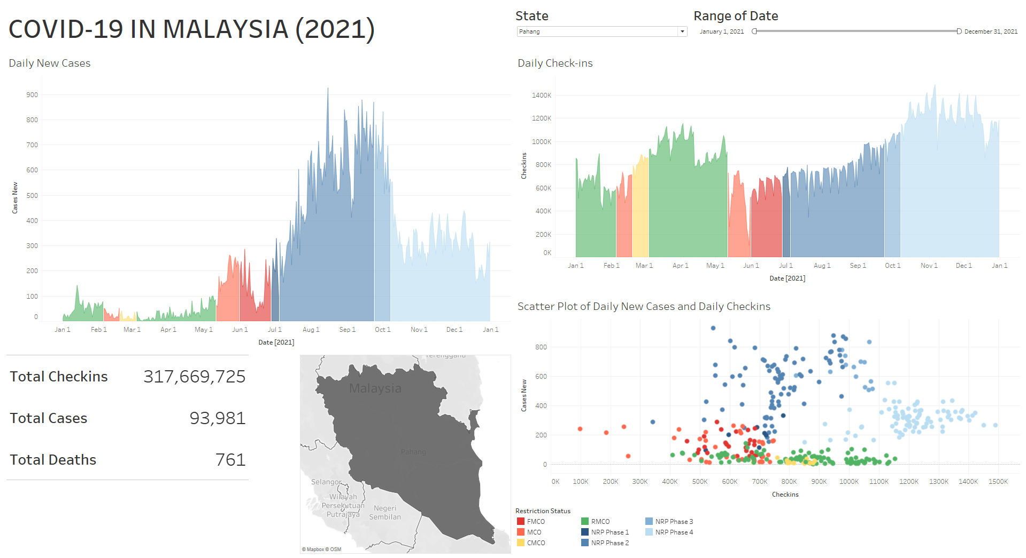
Overview of Dashboard 1
Dropdown box filter for state
Slider filter for range of date in 2021
Daily new cases by date
Daily check-ins by state
Summary for the selected state and range of date
Scatter plot for daily new cases and check-ins
Legend for Restriction Status

Slide 13
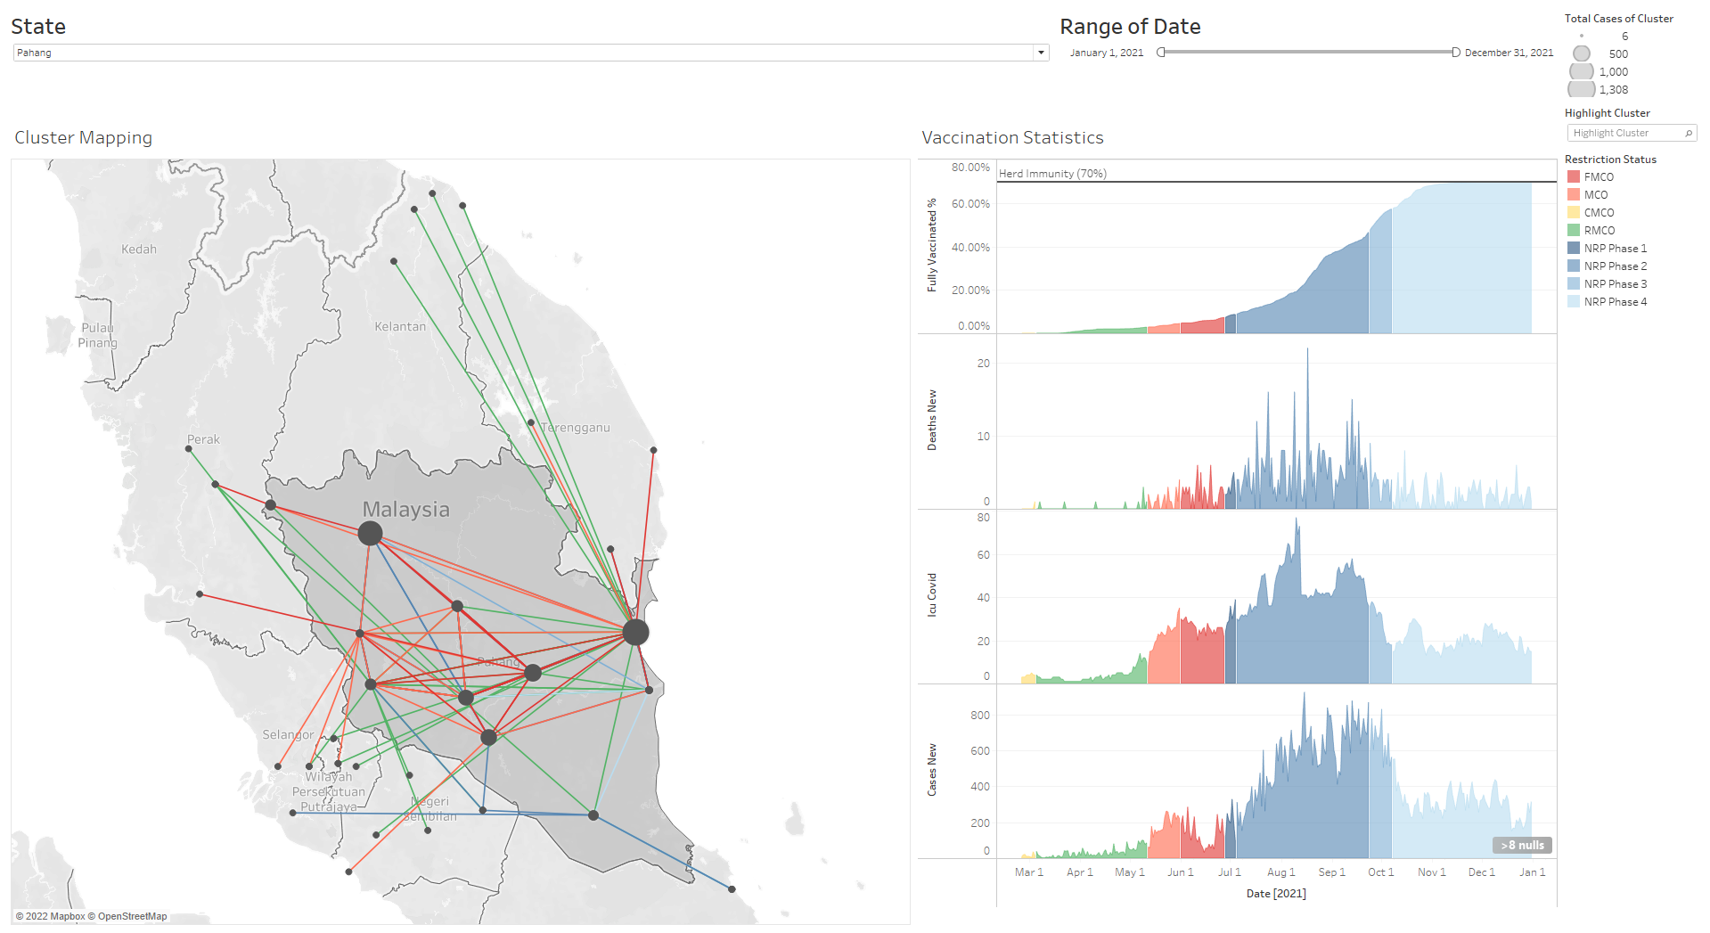
Overview of Dashboard 2
Dropdown box filter for state
Slider filter for range of date in 2021
Legend for Total cases of cluster
Network graph of clusters (Highlighted example in next slide)
Cluster highlighter to view a specific cluster
Legend for Restriction Status
Chart for Percentage of population that are fully vaccinated, Daily new deaths, Daily icu admissions and daily new cases by date.
Filtered state is shaded

Slide 14
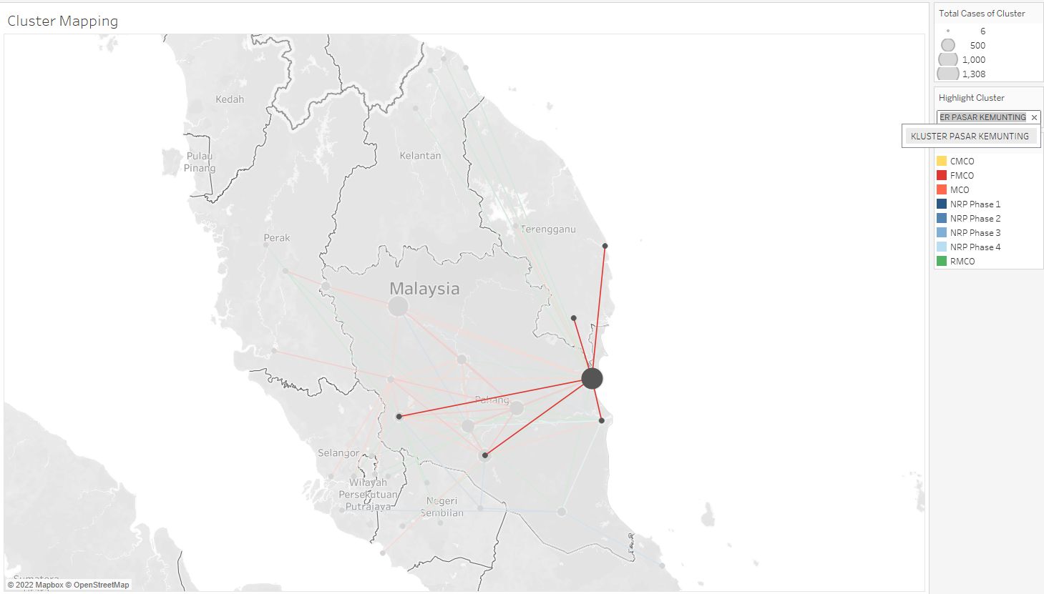
Highlighted cluster
Origin district of cluster, size of node corresponds to total cases of the cluster
Color of edge denotes the restriction status of the state at the time of the cluster.
Districts affected, exact amount of cases which are spreaded to here are unknown, hence the sizes are fixed.

Slide 15
Graph algorithm
The chosen graph algorithm is Dijkstra's algorithm, it will be implemented on Python. The aim of the algorithm is to find how the virus spread from district to district by finding the shortest path of transmission. The cluster dataset is transformed and geocoded in order to visualize and calculate the path of transmission.
Geographical coordinates for origin and destination
Total cases that are spread from the origin to the destination
Distance between origin and destination calculated by the Haversine formula. Assuming the earth radius is 6378km (earth radius at equator).

Slide 16
Prototype and Testing
Graph algorithm is implemented into the interface by using Python.
Python is required as Tableau does not have the functions for designing a graphing algorithm.
Indicates the shortest travelling path between one cluster to another.
This provides information to determine the relationship between two clusters.

Slide 17
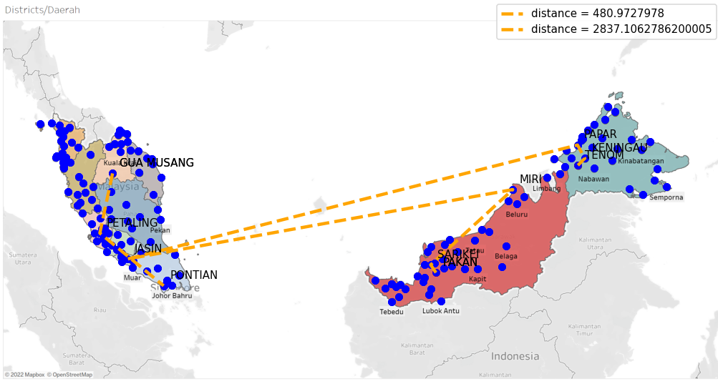
Prototype and Testing
Demonstration of the graphing algorithm from one point to another.

Slide 18
Conclusion
The data visualization interface was successfully implemented for the infected cases and the number of check-ins.
There presents other environmental factors such as the SOP or vaccination that causes the irregularities of the correlation.
A graphing algorithm was successfully implemented that identifies the shortest path of transmission between two clusters.

